Slide 1


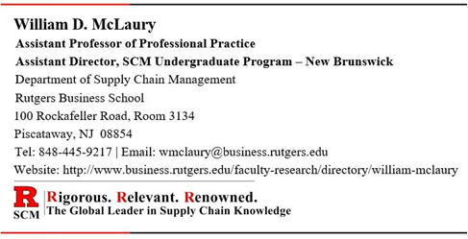
Supply Chain
Management
Purchasing Management
Anthony Taitt
Assistant Professor of Professional Practice
Department of Supply Chain Management
Rutgers Business School
100 Rockafeller Road, Rm. 3143, Piscataway, NJ 08854
Tel: 848-445-7796 | Email: ataitt@business.rutgers.edu
Website: https://www.business.rutgers.edu/faculty/anthony-taitt

Slide 2
Video Introduction
“Buy It” - Managing Supply
ASU Video Series (3 minutes)

Slide 3

Discussion Outline
Defining Procurement and Purchasing
The Basic Purchasing Process
Financial Significance of Purchasing
Make versus Buy Decision
Organization of Purchasing
International Purchasing
Government & Non-Profit Purchasing
Assessing and Improving the Purchasing Function

Slide 4
Procurement Defined
Plan, Source, Make, Deliver / Return, and Enable
Procurement - The process of selecting and vetting suppliers, negotiating contracts, establishing payment terms, and the actual purchasing of goods and services.
Procurement is concerned with acquiring all of the goods, services and work that is vital to an organization.
Procurement is the overarching or umbrella term within which the action of purchasing can be found.
PROCUREMENT
Chapter 05
Chapter 06
Chapter 07
PURCHASING
MANAGEMENT
STRATEGIC
SOURCING
SUPPLIER RELATIONSHIP MANAGEMENT

Slide 5
Purchasing Defined
Purchasing – The action of obtaining merchandise, capital equipment, raw materials, services, or maintenance, repair, and operating (MRO) supplies in exchange for money, or its equivalent.
Purchasing is the process of how goods and services are ordered from an external third party.
Purchasing can usually be described as the transactional function of procurement for goods or services.

Slide 6

Purchasing Defined (continued)
Purchasing is also a term commonly used in business to represent the function of, and the responsibility for, acquiring materials, supplies, and services for an organization.
It might be a separate department within a company, or it might be part of the supply chain management department within a company.

Slide 7

Supply Management
A newer term that encompasses all acquisition activities beyond the simple purchase transaction.
The Institute of Supply Management (ISM) defines Supply Management as the “Identification, acquisition, access, positioning, and management of resources an organization needs, or potentially needs, in the attainment of its strategic objectives.”
Includes the function of determining the materials and services that a company needs

Slide 8
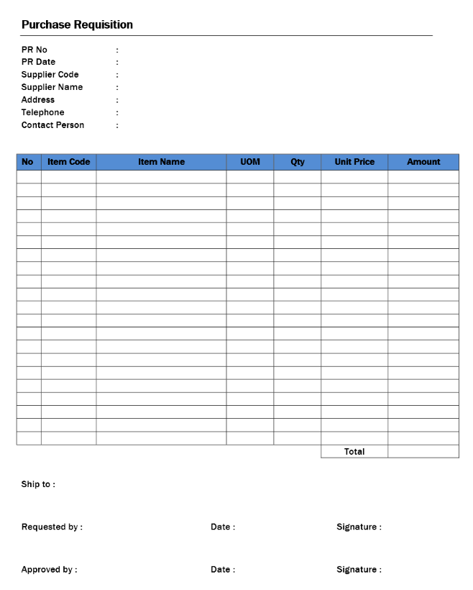
Purchasing Terms
Purchase Requisition – An Internal Document that defines the need for goods and/or services
Does not constitute a contractual relationship with an external party.
Generated by a user department to notify purchasing personnel of items to order, their quantity, and the timeframe.
It may also contain the authorization to proceed with the purchase.

Slide 9
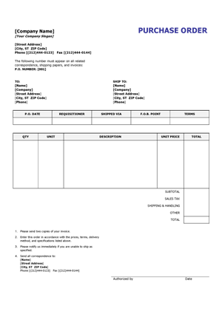
Purchasing Terms (continued)
Purchase Order (PO) is an external commercial document. It is the official offer issued by a buyer to a seller to acquire goods or services.
It is used to control the purchasing of products and services from external suppliers.
Indicates types, quantities, and agreed prices for products or services.
Becomes a legally binding contract only when accepted by the supplier.
Purchase Requisition ➔ Purchase Order + supplier confirmation of PO = binding contract

Slide 10
Purchasing Terms (continued)
e-Procurement - The business-to-business (B2B) purchase and sale of supplies and services over the Internet.
Merchants - Wholesalers and retailers who purchase for resale.
Industrial Buyers - Individuals within an organization who purchase raw materials for conversion into products, and/or purchase services, capital equipment, and MRO supplies.
Contracting - A term often used for the acquisition of services

Slide 11
Purchasing Terms (continued)
Request for Information (RFI) – A standard business process whose purpose is to collect written information about the capabilities of various suppliers.
Request for Proposal (RFP) - A detailed capabilities document used to determine a supplier's capability and interest in the production of a product or service.
Request for Quote (RFQ) - A document used to solicit bids (i.e., price and delivery) from interested and qualified suppliers for goods or services that the organization needs to obtain.

Slide 12

The Primary Objectives of Purchasing
Ensure an uninterrupted flow of materials and services at the lowest total cost.
Improve the quality of the finished goods produced.
Optimize customer satisfaction.

Slide 13

Purchasing Contributes to These Objectives by:
Actively seeking reliable suppliers.
Working with the expertise of strategic suppliers to improve quality and materials.
Involving suppliers and purchasing personnel in new product design and development efforts.

Slide 14
Discussion Outline
Defining Procurement and Purchasing
The Basic Purchasing Process
Financial Significance of Purchasing
Make versus Buy Decision
Organization of Purchasing
International Purchasing
Government & Non-Profit Purchasing
Assessing and Improving the Purchasing Function

Slide 15
Purchasing Process Steps
Industrial Purchasing Process
A need is identified, and a Purchase Requisition is issued
Request for goods or services submitted to the Procurement/Purchasing organization for action. Typically initiated by a user within an organization
Obtain authorization as necessary
A Purchase Requisition may be routed to an authorized approver(s) depending on the type of material or service being requested and/or the dollar value of the request.
Multiple authorizations, may be necessary if the value exceeds a specific threshold.
Identify and evaluate potential suppliers
May be determined from a list of approved Suppliers.
Alternatively, a Request for Information (RFI) may be used to collect information from potential suppliers on their capabilities in supplying the material or service.

Slide 16
Purchasing Process Steps (continued)
Make supplier selection
If the Buyer already knows which supplier they will buy from, move to step 3.
If not, a competitive bidding process may be initiated through the use of a Request for Proposal (RFP) or a Request for Quotation (RFQ).
Buyer issues a Request for Proposal (RFP) for items which have not been previously purchased, or not purchased from a specific supplier being evaluated. Supplier(s) provides their proposal to supply the item(s) including price and delivery.
Buyer issues a Request for Quotation (RFQ) for routine or repeat purchased items. Supplier(s) provides a price and delivery quote on the specific item(s) requested.
A Supplier is selected from the RFP or RFQ bids received based on criteria determined by the Buyer, including price, availability, quality, delivery costs, etc.

Slide 17
Purchasing Process Steps (continued)
Purchase Order (PO) is created and delivered to the supplier.
To inform the supplier of the intent to purchase.
To identify the item(s) to be procured, the quantity required, the requested delivery date(s), the price to be paid, the delivery location, and any terms and conditions that relate to the order.
The PO is the Buyer’s formal offer to the supplier to obtain the item(s).
Supplier confirmation of the Purchase Order
The Supplier formally agrees to supply the item(s) per the specifications, terms, and conditions described on the Purchase Order.
The Purchase Order then becomes a legally binding contract between the Buyer and the Supplier for the item(s) specified.
NOTE: The PO becomes a binding contract only when accepted and confirmed by the supplier.

Slide 18
Purchasing Process Steps (continued)
Fulfillment
The supplier delivers the item(s) to the buying organization as per the PO.
Receipt of Goods
Once the item(s) arrives at the designated location, the Buyer will typically conduct some form of receipt process where the item(s) are checked to ensure that they conform to the details of the PO, including quality and quantity.
A confirmation of receipt may also be sent to the Supplier.
Invoice and Reconciliation
The Supplier prepares an invoice for the item(s) ordered. The invoice either accompanies the item(s) or is sent separately to the Buyer.
The invoice may need to be reconciled to the purchase order and goods receipt before payment is made. Referred to as a “3-way match” (i.e., Invoice, Purchase Order, and Goods Receipt must match)

Slide 19
Purchasing Process Steps (continued)
Payment
Payment is processed using an appropriate payment method assuming the item(s) is received and meets all of the criteria established on the PO.
Close out the Purchase Order
If the PO has been received complete, and all terms and conditions have been met, then the PO should be closed out in the purchasing system.
If the PO has not been received complete, a decision must be made as to whether the balance will be received, or the order will be considered complete and then closed out.
Analysis
Measurements of the efficiency and accuracy of the procurement process.
Specific PO data and information captured and used during periodic supplier performance meetings.

Slide 20

Purchasing Process Steps (continued)
In leading procurement organizations, every step will be completed, although many of the steps will be completed via an automated system using pre-defined rules for aspects such as low-dollar value purchase, non-strategic purchases, etc.

Slide 21

e-Procurement
e-Procurement is the term used to describe the automation, through web-enabled tools, of the non-strategic and transactional activities that would otherwise consume the majority of a buyer’s time.
e-Procurement tools typically automate all or part of the following processes:
Solicitation tools such as RFI, RFP, RFQ
Execution and analysis
Reverse auction capabilities
Automation Provides increased visibility of all purchases.

Slide 22
e-Procurement (continued)
The basic e-procurement process consists of:
An electronic purchase requisition and/or purchase order
An invoice (which might be one with the receipt)
A payment.
For high-dollar purchases, the process will generally also include:
Authorization of the purchase order
Reconciliation of the invoice.

Slide 23

Advantages of an e-Procurement System
Time savings - A reduction in the time between need recognition and the release and receipt of an order
Cost savings - Lower overhead costs in the purchasing area
Accuracy - A reduction in errors. A virtual elimination of manual paperwork and paperwork handling
Real time - Improved communication both within the company and with suppliers
Management - Purchasing personnel spend less time on processing of purchase orders and invoices, and more time on strategic value-added purchasing activities
Mobility – Access virtually anywhere
Trackability – Real-time status tracking
Benefits to the suppliers

Slide 24
Discussion Outline
Defining Procurement and Purchasing
The Basic Purchasing Process
Financial Significance of Purchasing
Make versus Buy Decision
Organization of Purchasing
International Purchasing
Government & Non-Profit Purchasing
Assessing and Improving the Purchasing Function

Slide 25

The Financial Significance of Purchasing
Profit-Leverage Effect
A decrease in purchasing expenditures directly increases profits before taxes (assuming no decrease in quality or purchasing total cost).
Bottom line impact is $ for $
Return on Assets (ROA) Effect
A high ROA indicates managerial prowess in generating profits with lower spending
Inventory Turnover Effect
Increased inventory turnovers indicate optimal utilization of space and inventory levels, increased sales, avoidance of inventory obsolesce.
Inventory is an asset but it is also capital tied up

Slide 26
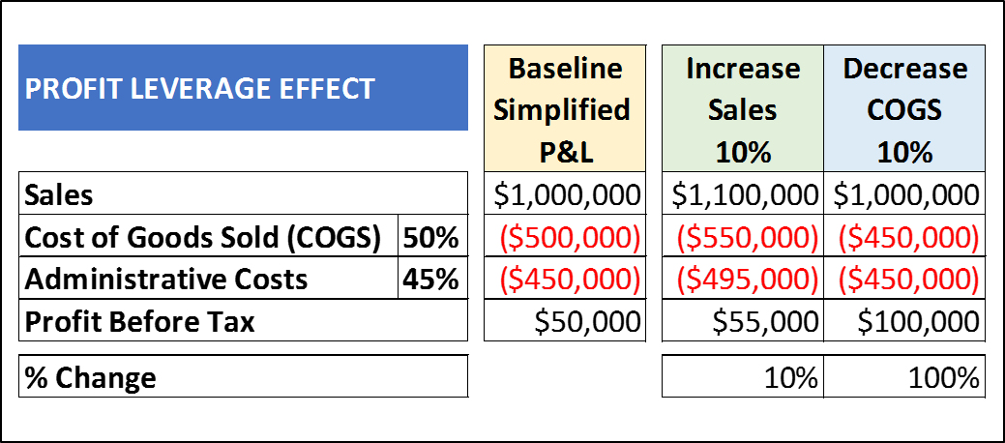
Profit-Leverage Effect
A 10% Cost Reduction generates significantly more Profit Before Tax than does a 10% Sales Increase.
This is one of the main reasons that Procurement Managers are under significant pressure from senior management to reduce purchase costs.

Slide 27
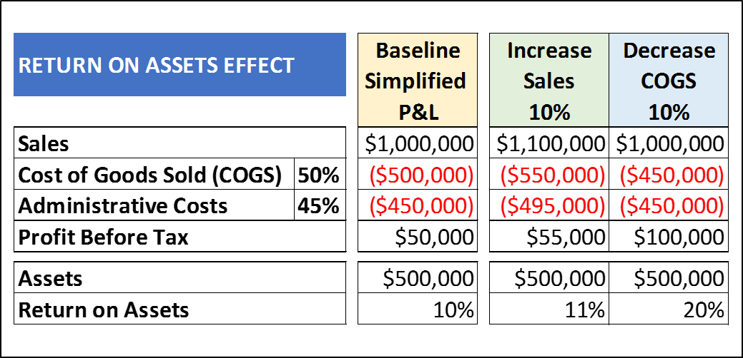
Return on Assets (ROA) Effect
[Profit Before Tax ÷ Assets = ROA]
a 10% cost reduction generates a significantly higher Return on Assets (ROA) than does a 10% sales increase, given the same number/value of assets.

Slide 28
Inventory Turnover Effect
Inventory is an asset but it also represents financial capital tied up and not available for use in other parts of the business.
The purchasing function in an organization is frequently responsible for Supply Management and therefore plays a large part in the amount of inventory the company holds.
Inventory turnover represents the number of times the company sold through inventory in a given time period.
Costs of Goods Sold (COGS) ÷ by the Average Inventory
A high turnover ratio is beneficial because it means the company is generating sales efficiently to sell inventory.
A low turnover ratio is unfavorable as it means the company is not selling through products efficiently. The company is likely making/buying too much inventory for demand and may end up throwing out expired or unsaleable products.

Slide 29
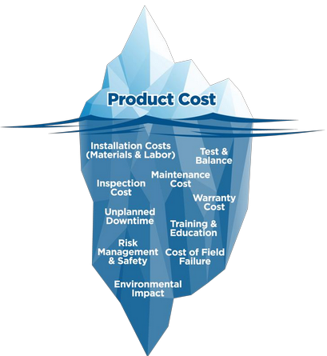
Total Cost of Ownership (TCO)
Total Cost of Ownership (TCO) is the sum of all the costs associated with every activity in the supply stream of a product.
https://www.youtube.com/watch?v=VtEYwdOSTpY
(2:10 minutes)
Procurement professionals recognize that although the purchase price of an item remains very important, it is only one part of the total cost of ownership.

Slide 30
Total Cost of Ownership (TCO)
The four elements of cost are: Quality, Service, Delivery, and Price (QSDP).
TCO is the sum of the cost elements in QSDP (i.e., Quality + Service + Delivery + Price = TCO)
Each element of QSDP has an impact on the TCO
The main TCO insight is that the acquisition cost is often a very small portion of the TCO
Accounting for only 25% to 40% of the total cost for most products.

Slide 31
Total Cost of Ownership (TCO)
Other factors beyond purchase price must also be considered:
Quantity Discounts may be offered to encourage buyers to purchase larger quantities.
Cash Discounts may be offered for prompt payment of invoices (e.g., 2% 10, Net 30).
Value-added Services may be offered such as:
Special delivery
Special packaging
Preparation of promotional displays
Subassembly operations in a supplier's plant.

Slide 32
Total Cost of Ownership (TCO)
Administrative Expenses associated with the procurement activity itself such as:
Screening potential suppliers
Negotiation
Order preparation
Order transmission
Poor Supplier Quality costs related to defective finished goods must also be considered. Costs such as:
Scrap
Rework
Recycling
Recovery of materials
Warranty administration
Repair costs

Slide 33
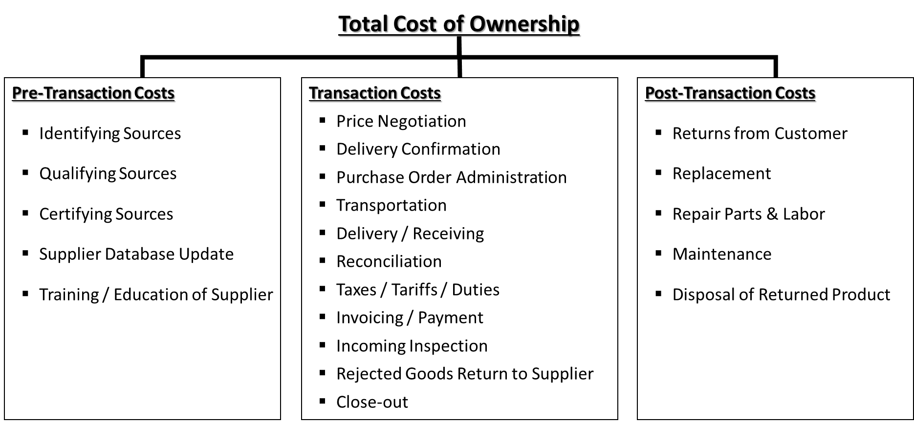
Components of the Total Cost of Ownership
Activities carried out prior to the actual buy and sell transaction.
Activities carried out as part of the actual buy and sell transaction
Activities carried out following the actual buy and sell transaction

Slide 34
Discussion Outline
Defining Procurement and Purchasing
The Basic Purchasing Process
Financial Significance of Purchasing
Make versus Buy Decision
Organization of Purchasing
International Purchasing
Government & Non-Profit Purchasing
Assessing and Improving the Purchasing Function

Slide 35

The Make versus Buy Decision
The Make versus Buy decision can be described as “the act of deciding whether to produce an item internally or buy the item from an outside supplier”.
Make: Producing (i.e., manufacturing) materials or products internally (i.e., in operations owned by the company).
Buy / Outsource: Buying materials, components, or products from a supplier(s) instead of, or in addition to, making them in-house (i.e., buying from a 3rd-party external source).
Make –vs– Buy
is a strategic decision
Make
-vs-
Buy

Slide 36

The Make versus Buy Decision (continued)
The make-vs-buy decision is ultimately based on three key pillars:
Business
Strategy
Economic
Factors
Risks

Slide 37
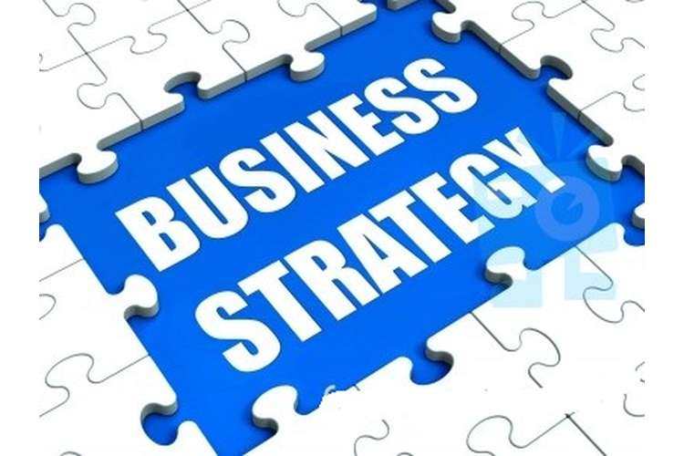
Pillar #1 - Business Strategy
Business Strategy includes the strategic importance to the company of the product or service that is being considered for outsourcing, as well as the process, technologies, or skills required to make the product or deliver the service.
These factors must be considered in today’s environment as well as how they may change in the future.
As a rule, it is desirable to choose in-house capabilities when a product or a function is critical to a company’s performance or is considered a core operation.

Slide 38
Pillar #2 - Risks
Risks include lower quality, reliability, and predictability of outsourced solutions as compared with in-house manufacturing or services, as well as risks inherent in the process of identifying and selecting the right supplier and structuring a workable ongoing relationship.
When there are multiple suppliers, a single failure in the supply chain may not be fatal.
When suppliers are making components rather than finished products, manufacturing errors will likely be caught during assembly and not be passed on to the consumer directly.
Because outsourcing introduces such a wide array of new risks, companies must be keenly aware of any potential pitfalls with suppliers, and evaluate outsourcing partners based on their importance to the organization.

Slide 39

Pillar #3 - Economic Factors
Economic Factors include the impact of outsourcing on capital expenditures, return on invested capital, and return on assets, as well as the possible savings achieved through outsourcing.

Slide 40
The Make versus Buy Decision
It is important to analyze all of the relevant expenses associated with developing the capability to make a product, compared to all of the expenses associated with buying the product.
Key factors that must be considered:
Qualitative Factors - are more subjective and include control over quality, the reliability and reputation of the potential suppliers (internal or external), and the impact of the decision on customers and suppliers.
Quantitative Factors - incremental costs of either making or purchasing the item, such as the availability of manufacturing facilities, needed resources, and manufacturing capacity.

Slide 41
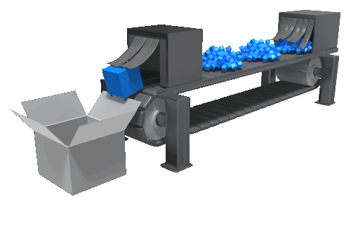
Qualitative Reasons for Making
Protect proprietary technology – You may not want your intellectual property to be out in the public domain.
No competent supplier – There may not be an existing supplier in the market, and you may not want to spend the time or effort to develop one.
Control of lead-time - You may feel that you have more control over the lead time to produce the product than a supplier.
Use existing idle capacity – Make use of excess capacity by making a material instead of letting the capacity sit idle.
Better quality control – You may feel that you have more control of the quality of the material / product than a supplier.

Slide 42
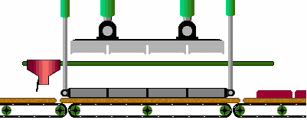
Quantitative Reasons for Making
Overall lower cost – You may be able to produce the material or product at a lower cost and avoid paying a 3rd party’s profit margin.
Control of transportation and warehousing costs – If you make an item in-house, you avoid transportation costs, and may be able to keep warehousing costs to a minimum.

Slide 43
Cost Factors for the Make Analysis
Direct labor expenses
Incremental inventory-carrying expenses
Incremental capital expenses
Incremental purchasing expenses (for starting/raw materials)
Incremental factory operating expenses
Incremental managerial expenses
Transportation expenses for purchased starting/raw materials
Any follow-on expenses resulting from quality and associated problems

Slide 44
Qualitative Reasons for Buying or Outsourcing
Non-Strategic - If it is a non-strategic item
Insufficient Capacity - A firm may be at or near capacity and subcontracting from a supplier may make better sense.
Temporary Capacity Constraints – the concept of “extended workbench” which involves short-term supplementing internal capacity with external capacity during time of constraint or overloaded work centers.
Lack of Expertise - Firm may not have the necessary technology and expertise
Quality - Suppliers may have better technology, process, & skilled labor
Multi Sourcing Strategy – To achieve a multi sourcing strategy using an external supplier in addition to an internal source.
Brand Strategy – take advantage of a supplier’s brand image, reputation, popularity, etc.

Slide 45

Quantitative Reasons for Buying or Outsourcing
Cost Advantage - Suppliers may provide the benefit of economies of scale, especially for components that are non-vital to the organization’s operations.
Inventory Considerations – opting to have the supplier hold inventory of the item or the materials required to produce the item.

Slide 46
Cost Factors for the Buy Analysis
Unit price of the purchased item
Transportation expenses
Incremental purchasing expenses
Receiving and inspection expenses
Any follow-on expenses associated with service or quality

Slide 47

Risks & Benefits of Outsourcing
Risks associated with outsourcing include:
Potential loss of control
Over production decisions, intellectual property, etc.
Increased reliance on suppliers
Increased need for supplier management
Benefits. Outsourcing allows a firm to:
Concentrate on core capabilities
Reduce staffing levels
Accelerate reengineering efforts
Reduce internal management problems
Improve manufacturing flexibility

Slide 48
Additional Make versus Buy Concepts
In-sourcing:
Reverting (i.e., going back) to in-house production when external quality, delivery, and services do not meet expectations
Co-sourcing:
The sharing of a process or function between internal staff and an external provider.
Using dedicated staff at an external provider that works exclusively under your control and direction

Slide 49
Other Types of Make/Buy Strategic Decisions
Backward Vertical Integration – Refers to a company acquiring (i.e., buying) one or more of their suppliers.
Example: a manufacturer buying the key supplier of a critical material to take ownership of this aspect of their supply chain.
Forward Vertical Integration – Refers to a company acquiring (i.e., buying) one or more of their customers.
Example: a manufacturer buying a wholesaler/distributor to take ownership of this aspect of their supply chain.
Suppliers
Customers
Tier 3
Tier 2
Tier 1
Manufacturer
(Finished Product)
Tier 1
Tier 2
Tier 3
Supplier
Supplier
Supplier
Customer
Customer
Customer
Backward
Forward
Vertical Integration
Vertical Integration

Slide 50
Discussion Outline
Defining Procurement and Purchasing
The Basic Purchasing Process
Financial Significance of Purchasing
Make versus Buy Decision
Organization of Purchasing
International Purchasing
Government & Non-Profit Purchasing
Assessing and Improving the Purchasing Function

Slide 51
Organization of Purchasing
Many companies have a Chief Procurement Officer (CPO) as part of their executive leadership team.
Chief Procurement Officer (CPO)
Head of
Strategic Sourcing
Purchasing
Manager
Category Manager
Category Manager
Category Manager
Category Manager
Buyer
Buyer
Buyer
Buyer
Administrator
Administrator

Slide 52

Centralized Versus Decentralized Purchasing
Purchasing Organization is dependent on many factors, such as market conditions and types of materials required
Centralized Purchasing: Purchasing department located at the firm’s corporate office makes all the purchasing decisions
Decentralized Purchasing: Individual, local purchasing departments, such as at the plant level, making their own purchasing decisions
Centralized/Decentralized Purchasing (Hybrid Approach): Centralized purchasing for products and services used throughout the corporation. Decentralized purchasing for products and services used only locally at each facility.

Slide 53
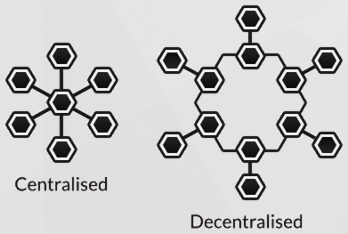
Centralized Versus Decentralized Purchasing (continued)
Advantages of Centralization
Concentrated volume
Leveraging purchase volume
Avoiding duplication
Specialization
Lower transportation costs
No competition within units
Common supply base
Advantages of Decentralization
Knowledge of local requirements
Local sourcing
Less bureaucracy

Slide 54
Discussion Outline
Defining Procurement and Purchasing
The Basic Purchasing Process
Financial Significance of Purchasing
Make versus Buy Decision
Organization of Purchasing
International Purchasing
Government & Non-Profit Purchasing
Assessing and Improving the Purchasing Function

Slide 55

International Purchasing - Reasons for Global Sourcing
The opportunity to improve quality, cost, and delivery performance
To exploit global efficiencies:
Access to low cost labor and materials.
Take advantage of tax breaks and low trade tariffs
To respond to insufficient domestic capacity
To achieve access to better process and product technology
Due to a change in the domestic business environment
To take advantage of reciprocal trade and countertrade arrangements

Slide 56
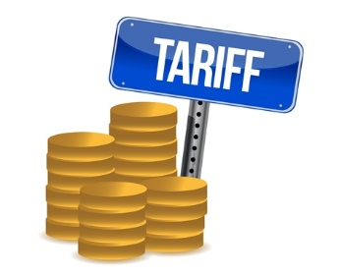
International Purchasing - Specialized Knowledge
Companies interested in pursuing international purchasing arrangements must acquire some specialized knowledge particular to buying products and services internationally.
This specialized knowledge includes aspects of:
Tariffs - Duties, taxes, or customs imposed by the host country for imported or exported goods.
Non-tariff Barriers – Quotas, licensing agreements, embargoes, laws and regulations imposed on imports and exports.
Countertrade – International trade by exchange of goods rather than by currency.

Slide 57
International Purchasing – Potential Challenges
Knowledge of international trade policies and procedures
Awareness and cost of required tariffs and duties
Difficulties in communicating with suppliers due to language barriers, varying time zones, working weeks, holidays.
Locating, evaluating, sourcing and expediting in global markets
Payments and currency management
Longer time span for negotiations
The potential for cultural, political, and labor problems
Potentially longer transportation lead times necessitating additional inventory
Specific and varying documentation requirements
Handling legal matters and the process for settling disputes

Slide 58
International Purchasing – Service Providers
Companies can choose to use service providers that already have the specialized skills and knowledge necessary to deal with international purchasing issues and challenges.
Some of the entities offering these specialized skills and knowledge are:
Import Brokers – Agents licensed by the governmental regulatory authority to conduct business on behalf of importers, for a service fee.
They take the burden of filling out import paperwork, and clearing products through customs barriers for importers
Import Merchants - A person or company engaged in the purchase and sale of imported commodities for profit.
They buy and take title to the goods being imported and then sell the goods domestically.
Trading Companies - Buy products in one country and sell them in different countries where they have their own distribution network.
They mostly work with high production volume products such as raw materials, chemicals, etc. They may carry wide variety of goods (such as from a catalog).

Slide 59
Discussion Outline
Defining Procurement and Purchasing
The Basic Purchasing Process
Financial Significance of Purchasing
Make versus Buy Decision
Organization of Purchasing
International Purchasing
Government & Non-Profit Purchasing
Assessing and Improving the Purchasing Function

Slide 60

Government & Non-Profit Purchasing
Government purchases are expenditures made in the private sector by all levels of government.
Non-Profit purchases are expenditures made in the private sector by all types of non-profit organizations.
Government sector purchasing and non-profit sector purchasing is somewhat different from private industrial purchasing as the public requires openness, visibility and accountability since it is the public’s money that is being spent.

Slide 61

Government & Non-Profit Purchasing - Terms
Bid - A proposal or quotation submitted in response to a solicitation from a contracting authority.
A Sealed Bid is enclosed in a sealed envelope and submitted in response to an invitation to bid.
Competitive Bidding - A procurement process in which bids from competing suppliers, for the right to supply specified materials or services, are requested.
This process is generally initiated by advertising the scope, specifications, and terms and conditions of the proposed contract as well as the criteria by which the bids will be evaluated, either openly or to a selected group of potential bidders.

Slide 62
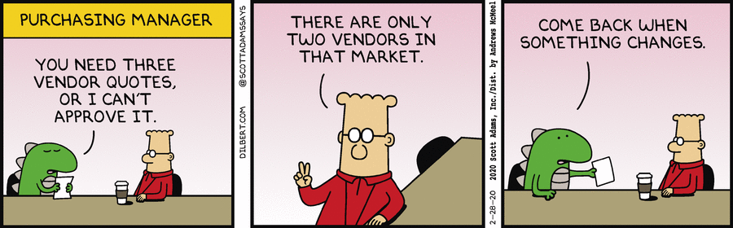
Competitive Bidding
Competitive bidding aims at obtaining goods and services at the lowest prices by stimulating competition, and by preventing favoritism.
Open competitive bidding - the sealed bids are opened in full view of all who may wish to witness the bid opening
Closed competitive bidding - the sealed bids are opened in presence only of authorized personnel.
The competitive bidding process does not allow for negotiations. By law, the contract is awarded to the lowest priced responsive and responsible bidder.

Slide 63
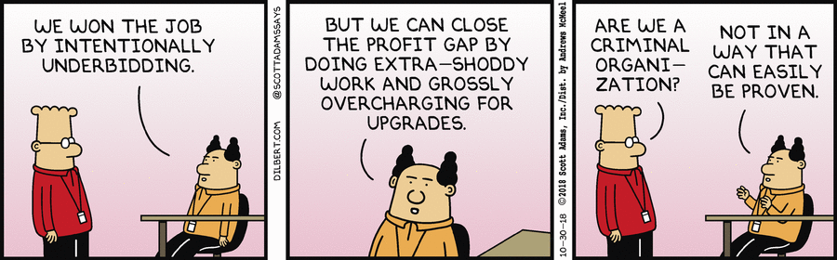
Government & Non-Profit Purchasing - Bonds
Bidders are generally required to furnish bonds as an incentive to ensure that the successful bidder will fulfill the contract awarded.
Bid Bond is a debt secured by a bidder for the purpose of providing a guarantee that the successful bidder will accept the contract once awarded. If not, the bond would be forfeited.
Performance Bond is a debt secured by a bidder for the purpose of providing a guarantee that the work will be on time and meet specifications.
Payment Bond is a debt secured by a bidder for the purpose of providing protection against 3rd party liens not fulfilled by bidder

Slide 64
Discussion Outline
Defining Procurement and Purchasing
The Basic Purchasing Process
Financial Significance of Purchasing
Make versus Buy Decision
Organization of Purchasing
International Purchasing
Government & Non-Profit Purchasing
Assessing and Improving the Purchasing Function

Slide 65
Assessing and Improving the Purchasing Function
The purchasing function is one of the most value-enhancing functions in any organization
It is preferable to periodically monitor the purchasing function’s performance against set standards, goals, and/or industry benchmarks.
Surveys or audits can be administered as self-assessments among purchasing staff as part of the annual evaluation process.

Slide 66

Benchmarking Successful Sourcing Practices
Benchmarking: is a process of measuring the performance of a company's products, services, or processes against those of another business considered to be the best in the industry, aka “best in class.”
The point of benchmarking is to identify internal opportunities for improvement.
Resources for learning about and implementing sourcing practices:
The Center for Advanced Purchasing Studies.
Council of Supply Chain Management Professionals (CSCMP)
Institute of Supply Management (ISM)

Slide 67
Assessing and Improving the Purchasing Function
Example Assessment Criteria:
Optimizing the supply base
Utilizing e-procurement
Furthering supplier integration
Initiating supplier cost reduction programs
Creation of strategic alliances
Participating in value engineering efforts
Creating ESI initiatives
Contributing to new product development
Improving time to market
Participating in, and leading, multifunctional teams

Slide 68
Assessing and Improving the Purchasing Function
Skill set requirements of purchasing professionals have been changing. Purchasing personnel must today exhibit world-class skills such as:
Interpersonal communication
Ability to make decisions
Ability to work in teams
Analytical skills
Negotiation skills
Customer focus
Ability to manage change
Influencing and persuasion skills
Strategic skills
Understanding business conditions

Slide 69
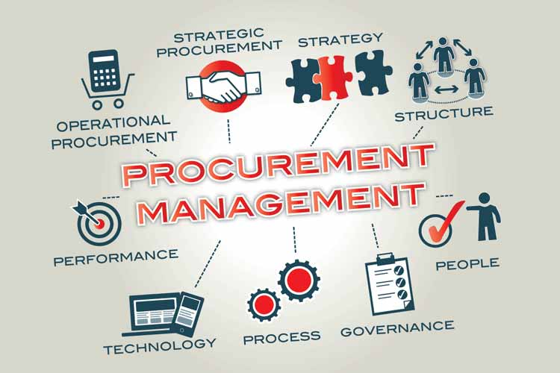
End of Chapter 5

